Slide 1
Highly accurate protein structure prediction with AlphaFold By John Jumper et al.
Presentation by TJ LaGrow
TReNDS Center MLBBQ
2/18/2022

Slide 2
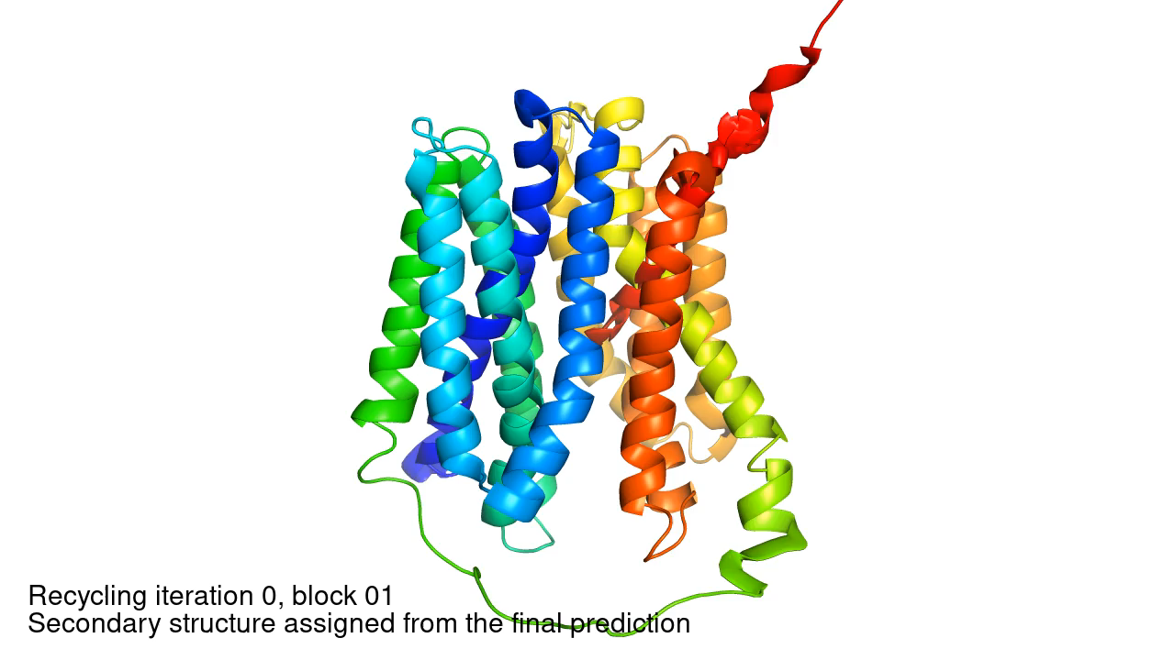
Overview
Introduction to the Folding Protein Problem
AlphaFold1
MSA’s
Distograms
AlphaFold2
Preprocessing
Evoformer
Structure Model
Training
Future Work
Did DeepMind Solve Proteins?

Slide 3
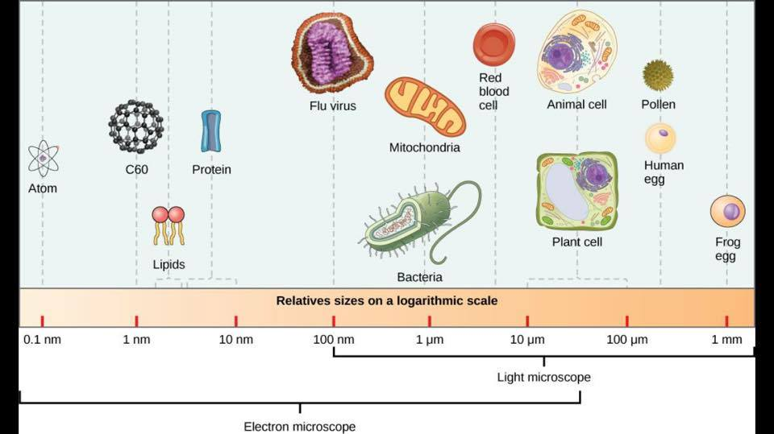
What are Proteins?
Carry out all important functions in the body
Digest Food
Contract Muscles
Fire Neurons
Power the Immune System
“(Almost) Everything in Biology Occurs because of Proteins” – David Baker
Roughly speaking, proteins are around 3-6 nm in diameter, which significantly varies protein to protein.
Image Source: https://cleanhomehealthyfamily.wordpress.com/norwex-demonstration/protein-vs-virus-vs-bacteria-size-chart/

Slide 4
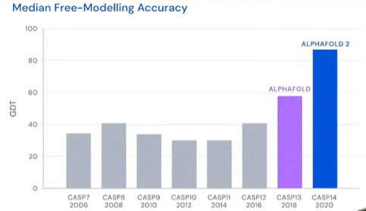
The Protein Folding Problem
In 1972, Christian Anfinsen (Nobel Laureate - Chemistry)
“…a protein’s amino acid sequence should fully determine its structure.”
Sparked 50 years of trying to predict the 3D structure from the amino acid sequence.
In 1969, Cyrus Levinthal postulated that it would take longer than the age of the universe to brute force the complexity of all 3D structures of the proteins.
Led to Levinthal’s Paradox, since protein structures fold spontaneously in natures almost instantaneously creating a conflicting dichotomy.
Led to the notion that nature must be using predictable folding patterns to arrive at the native state of a protein so reliably and rapidly.
Previous computational methods were not practical enough to be
clinically relevant.
Data Availability
Worldwide Protein Data Bank (PDB)
All known protein structures using X-Ray Crystallography
(~$12,000 for single protein run) with highly specialized
scientists to analyze the anatomic and molecular structures.
CASP13 and CASP14 Competitions

Slide 5
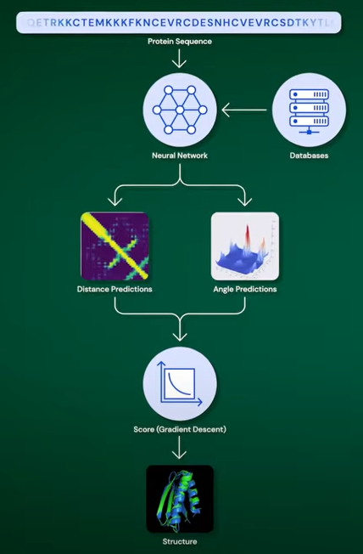
AlphaFold1
What is a Multiple Sequence Alignment (MSA)?
Observation: when studying different evolutionary lines of organisms, scientists know that the 3D structure of proteins are much more stable over time than the genetic sequence that encodes that protein.
Mutations to the genetic sequence are quite common in nature but changes in structure are much rarer.
Proteins need to keep carrying out the same functions over the course of evolution.
The genetic mutations that survive are the ones that do not change the protein structure.
Thus, a sequence is run through a database of known structures from evolutionary lines to predict what the protein might be for correct structure.

Slide 6
AlphaFold1
What is a Multiple Sequence Alignment (MSA)?
Observation: when studying different evolutionary lines of organisms, scientists know that the 3D structure of proteins are much more stable over time than the genetic sequence that encodes that protein.
Mutations to the genetic sequence are quite common in nature but changes in structure are much rarer.
Proteins need to keep carrying out the same functions over the course of evolution.
The genetic mutations that survive are the ones that do not change the protein structure.
Thus, a sequence is run through a database of known structures from evolutionary lines to predict what the protein might be for correct structure.
Why not just use the sequence data to 3D protein structure?
Notes:
There is a vast array of information we can glean from the evolutionary data.

Slide 7
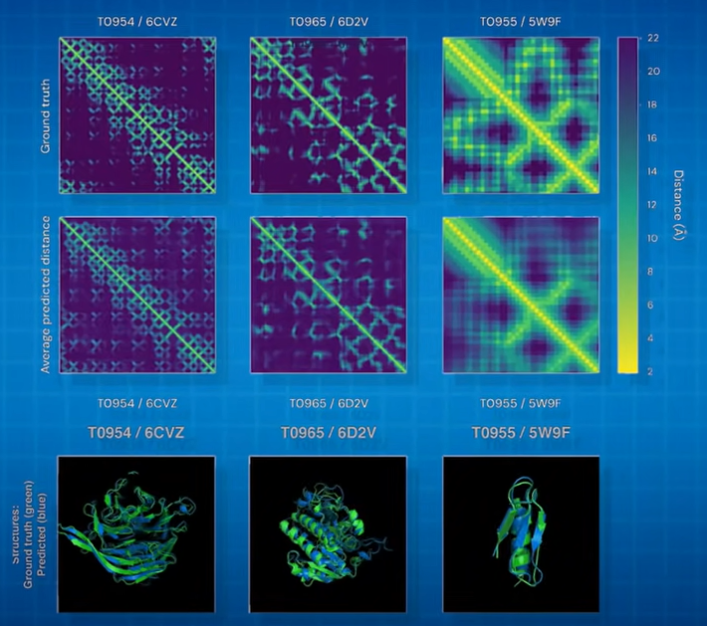
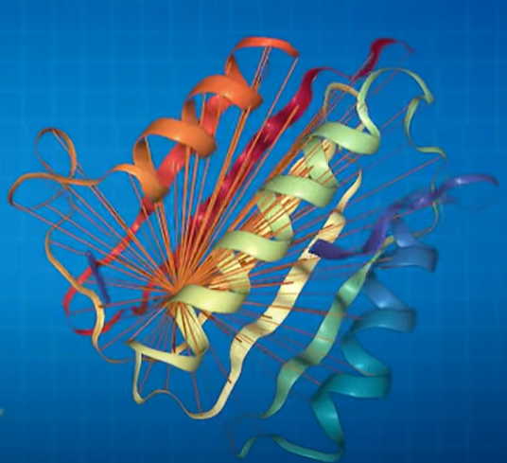
AlphaFold1
What is a Distogram?
2D array of distances between ever pair of residues in the protein.
Row[i], Col[j] will represent the distance between amino acid pairs.
Thus, distograms are 2D projections of the 3D structures.
Symmetric matrix.

Slide 8
AlphaFold1
What is a Distogram?
2D array of distances between ever pair of residues in the protein.
Row[i], Col[j] will represent the distance between amino acid pairs.
Thus, distograms are 2D projections of the 3D structures.
Symmetric matrix.
Why not just use 3D Cartesian
coordinates?
Notes:
The distograms are invariant to rotation and translations. Makes the target much easier to learn.

Slide 9
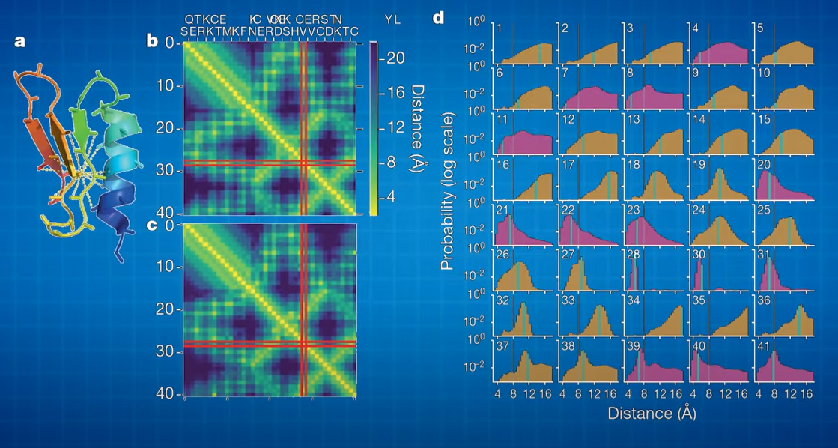
AlphaFold1
What is a Distogram?
2D array of distances between ever pair of residues in the protein.
Row[i], Col[j] will represent the distance between amino acid pairs.
Thus, distograms are 2D projections of the 3D structures.
Symmetric matrix.
Notes:
Rather than predict the target distogram, predicts a distribution of 64 distance bins between 2 residues.

Slide 10
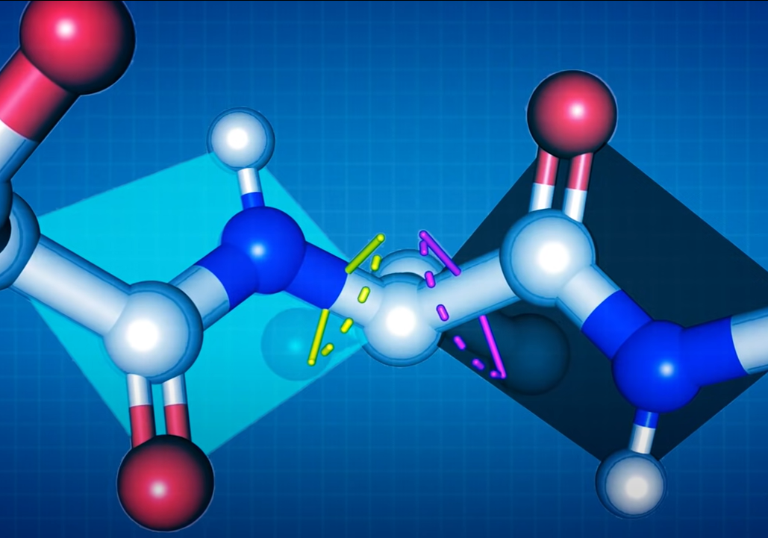
AlphaFold1
Then uses Gradient Descent
Predicting the Phi and Psi angles in atomic structure.
Using a scoring function that combines the predictions of the neural network with physical simulated forces.

Slide 11
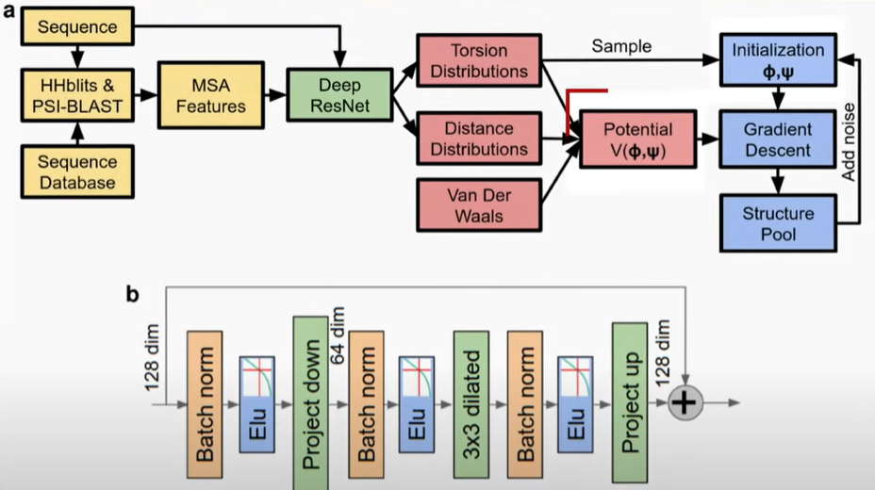
AlphaFold1
Then uses Gradient Descent
Predicting the Phi and Psi angles in atomic structure.
Using a scoring function that combines the predictions of the neural network with physical simulated forces.
Notes:
This is to get the most likely confirmation between protein model.

Slide 12
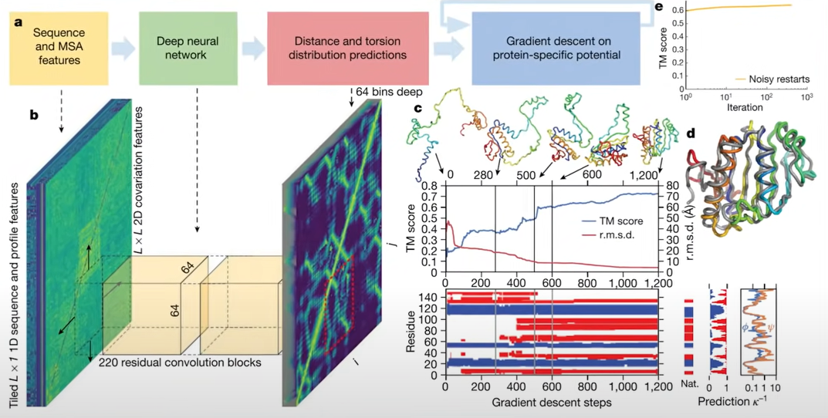
AlphaFold1
Notes:
Thus we get out model.

Slide 13
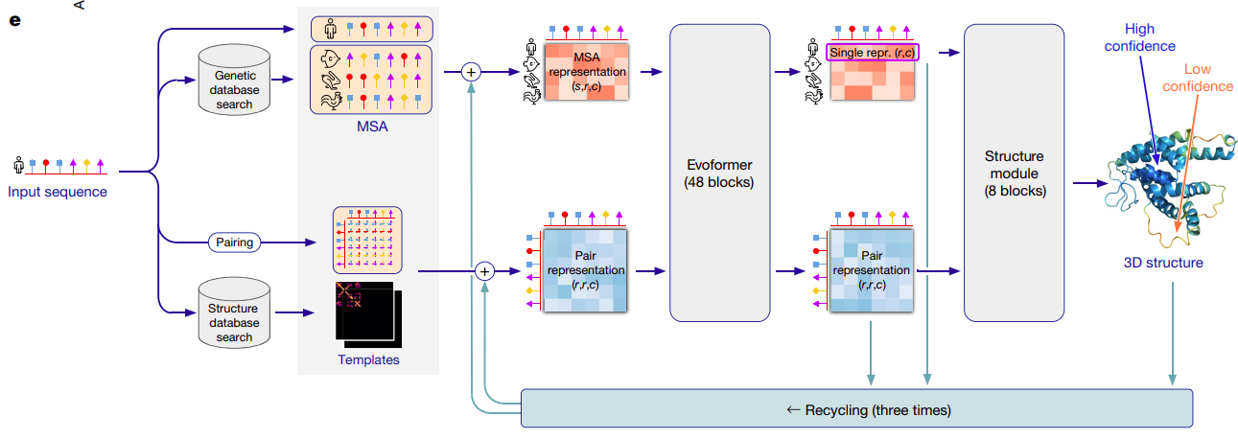
AlphaFold2
Three Major Components to the Algorithm:
Preprocessing Stage
MSA and Pair Representation with the Evoformer
Structure Module
Notes:
There are other efforts in this space as well, which the paper acknowledges briefly.
Great work done by the Baker Lab at UW, trying to replicate the achievements of AlphaFold.
DeepMind refrained from publishing the paper for almost a year after announcing alphafold2, extremely worried about getting scoped.
Preprocessing Stage used to take input sequences and query additional information from external databases.
Then mapped to an MSA and Pair representation, refined by the Evoformer. This is a 48-layer deep transformer-like network using attention networks to update the weights of the msa and pair representations.
Structure module transforms the abstract representations from the evoformer into conceit 3 dimential coordinates of the protein geometry.

Slide 14
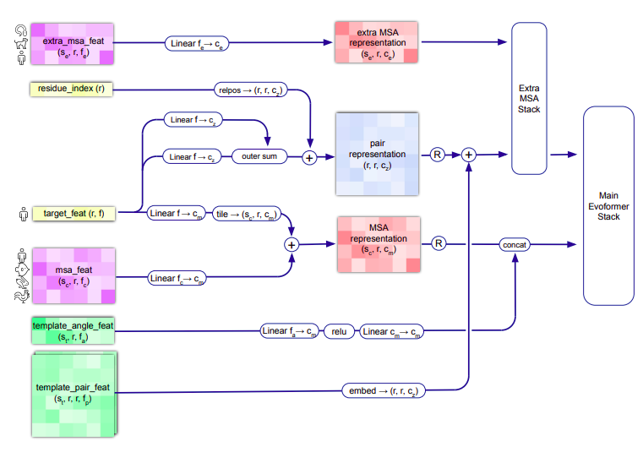
AlphaFold2
Notes:
Preprocessing pipeline is usually repeated several times leading to different pair and msa representations which can be averaged together before flowing int the evoformer.

Slide 15
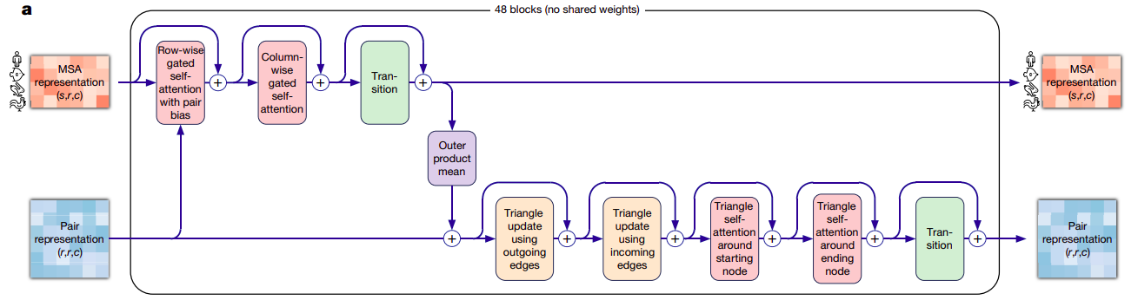
AlphaFold2
Evoformer Module
Notes:
All 48 blocks have individual parameters so it’s not a recurrent network like the structural model.
Has pair of MSA and pair representation as both input and output.
Attempting to learn the spatial and evolutionary pairing the of the representational structure.

Slide 16
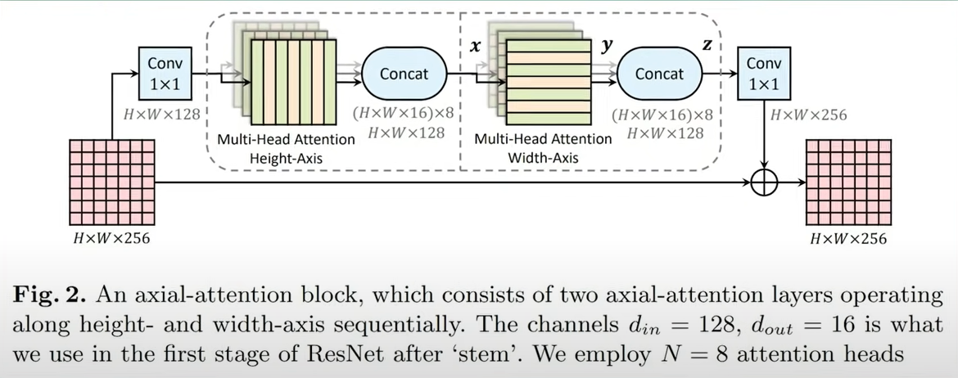
AlphaFold2
Evoformer Module
Notes:
All 48 blocks have individual parameters so it’s not a recurrent network like the structural model.
Has pair of MSA and pair representation as both input and output.
Attempting to learn the spatial and evolutionary pairing the of the representational structure.
By alternating layers of row-wise and col-wise, where row wise aligns each of the aligned sequences separately, where column wise reasons between different residuels with different sequences of the MSA. Plus pair-wise representation is fed into the axial-attention block for further information. Then also follows back down into the pair representation pathway.
This operation is performed for all 48 blocks of the evoformer.

Slide 17
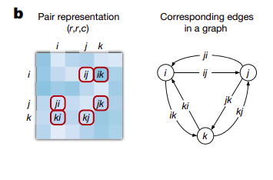
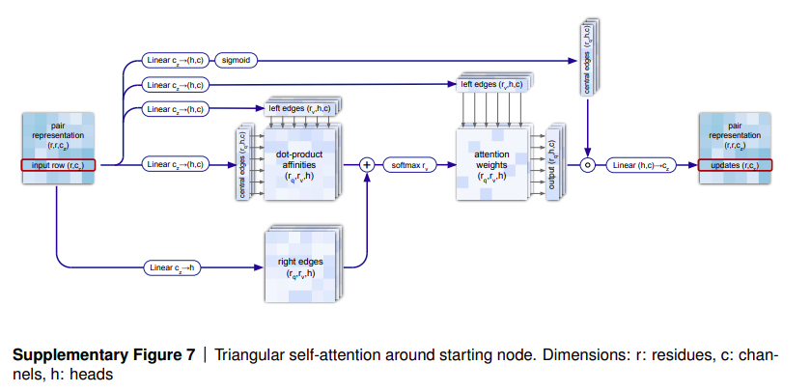
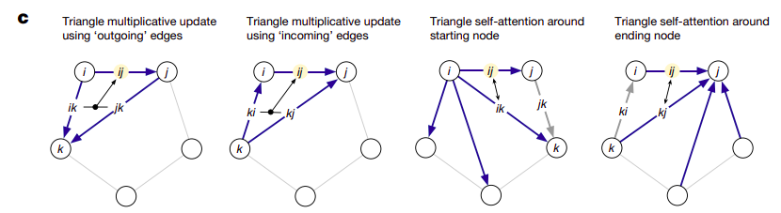
AlphaFold2
Evoformer Module

Slide 18
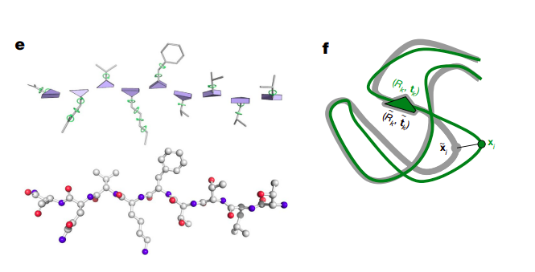
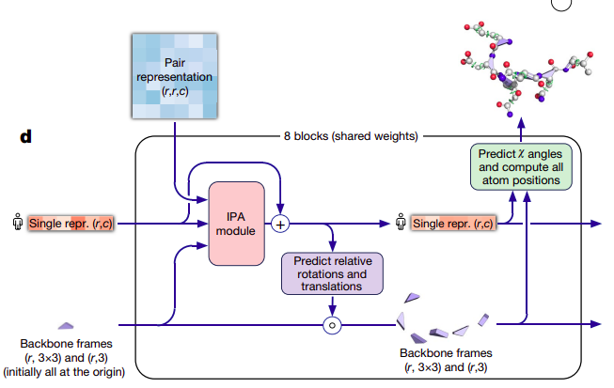
AlphaFold2
Notes:
Transforms MSA and pair representation from abstract representations to 3D structures.
Takes each layer of the MSA representation to 8 network layers that all share the same weights. So this is essentially a recurrent network that iteratively updates the structure of the protein.
These fundamental constraints can disobey laws of physics, but work remarkably well.
The authors initialize the first 3D coordinates to the model with the identity function, called the “black hole initialization” which means the structure module will initialize each of the residues at the same point of origin and update the model accordingly.
Once Initialize, the residue “gas” is updated in two stages:
Invarient point attention module (update sequence representation without changes the structure of the sequences) (lots of tricks, did not get to this in the supplementary data)
Then an equivariant update is performed on the residue gas using the updated sequence representation, keeps activation weights invariant to rotations/translations much like many CV problems
Also use Quaternions…represented by 4 numbers rather than 9 numbers needed for standard cartisian graphs. Interpelation between angels are a smooth process so it make GD much easier to solve.
Finally shallow resnet to predict the torsion angles of each residue to refine the structure in atom side chains.

Slide 19
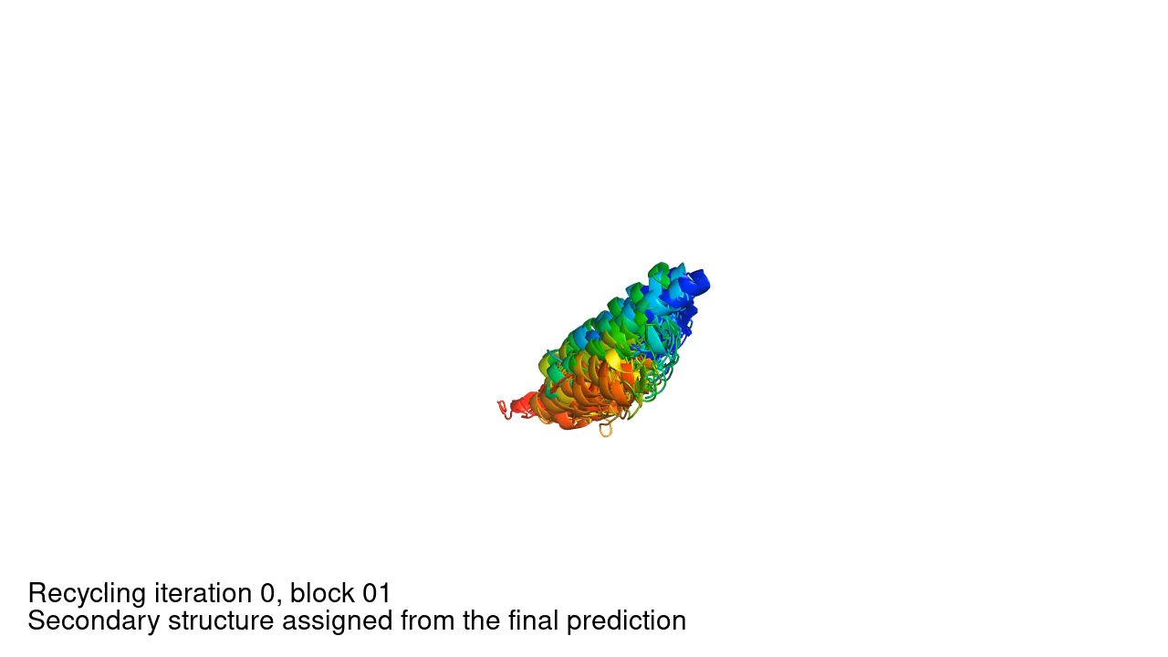
AlphaFold2
Notes:
Transforms MSA and pair representation from abstract representations to 3D structures.
Takes each layer of the MSA representation to 8 network layers that all share the same weights. So this is essentially a recurrent network that iteratively updates the structure of the protein.
These fundamental constraints can disobey laws of physics, but work remarkably well.
The authors initialize the first 3D coordinates to the model with the identity function, called the “black hole initialization” which means the structure module will initialize each of the residues at the same point of origin and update the model accordingly.
Once Initialize, the residue “gas” is updated in two stages:
Invarient point attention module (update sequence representation without changes the structure of the sequences) (lots of tricks, did not get to this in the supplementary data)
Then an equivariant update is performed on the residue gas using the updated sequence representation, keeps activation weights invariant to rotations/translations much like many CV problems
Also use Quaternions…represented by 4 numbers rather than 9 numbers needed for standard cartisian graphs. Interpelation between angels are a smooth process so it make GD much easier to solve.

Slide 20
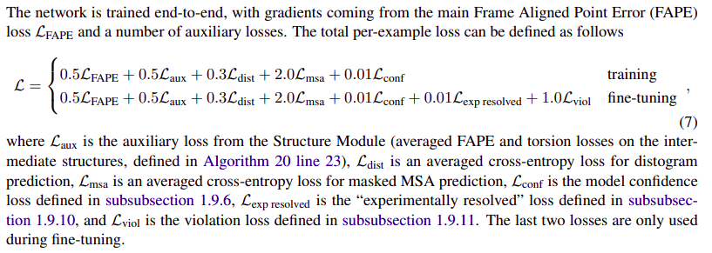
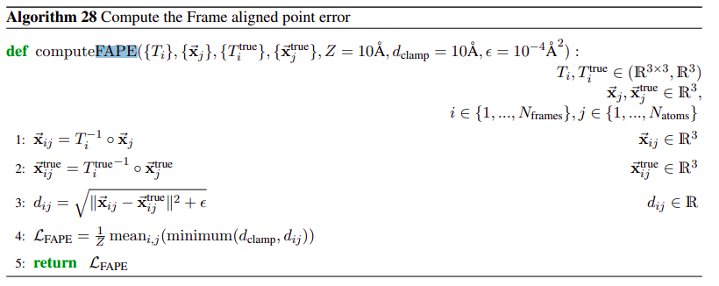
AlphaFold2
How is the algorithm trained? Using 4 combined loss components. FAPE (Frame Aligned Point Error)
Notes:
Focus on substructures first rather than each individual atom
Distance measure with cross entropy attached.
Random masking is used (much like BERT)
AlphaFold tries to think how close it is used to get close

Slide 21
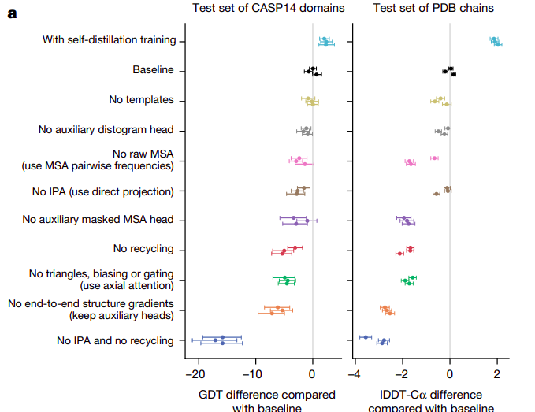
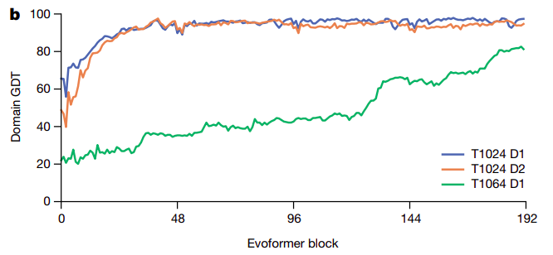
Further?
Self-Distillation and Ablation Study
Notes:
Only high precision new proteins are used
Recycling is also used.

Slide 22
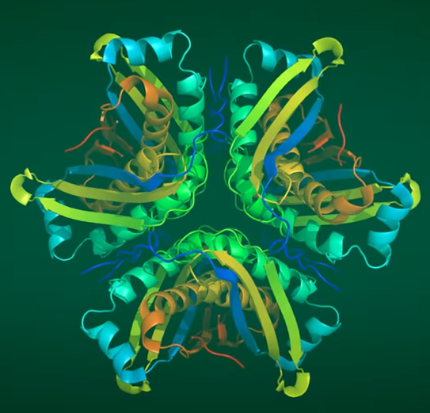
Is Protein Folding Solved?
Bottomline: No, but great start!
AlphaFold’s accuracy is not quite perfect.
Many interactions between complex protein structures not handled by AlphaFold
Generalization?
Notes:
Only high precision new proteins are used
Recycling is also used.
Training set is used on biological relevant in nature, designer proteins might be outside of this distribution.

Slide 23
Thank you!
Notes:
Only high precision new proteins are used
Recycling is also used.
Training set is used on biological relevant in nature, designer proteins might be outside of this distribution.

